Slide 1
FHIM Prototype Overview

Slide 2
To Do:
Apply ONC template

Slide 3
Overview
Approach
Lessons Learned
Next Steps

Slide 4
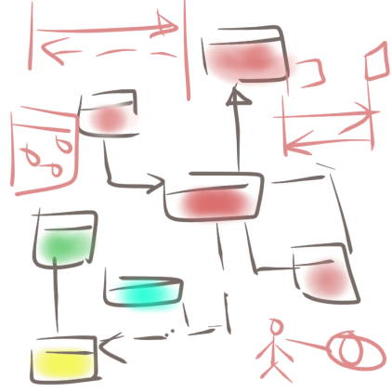
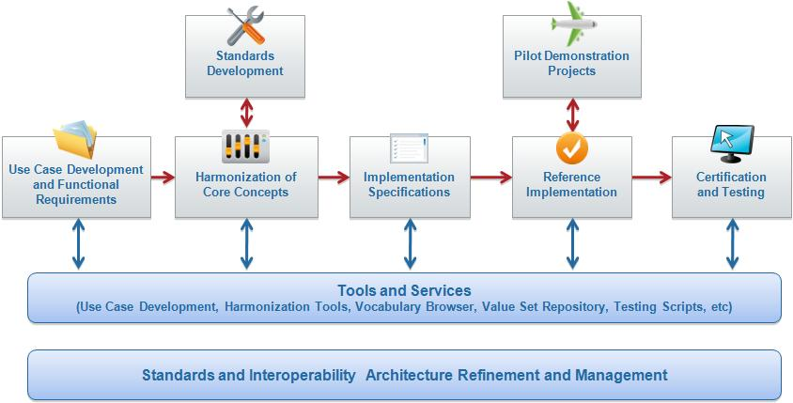
Standards Change Requests
3
Use Cases Functional Requirements
1
2
Implementation specification
NIEM IEPD
CDA IG
FHIM
Terminology Service

Slide 5
Prototype Steps - 1
FHIM.emx
FHIM.emx
HITSP IS01
1
3
Use Case
Information
Requirements
Semantic Model Metadata
2
Harmonized
HITSP C35. C36, C37, C83
Coded Concept
Value Set Binding
HITSP C80/35
Terminology Model
Standard Coding System
Standard Coding System
Standard Coding System
Standard Coding System

Slide 6
Prototype Steps -2
CDA HITSP C37
FHIM.emx
Constraints
Clinical Document
Header
4
*
*
Section
*
*
5
Entry
Constraints
Choice
Act
NIEM
Extensions
Encounter
References
Extension
Observation
Media
Use Case
Organizer
Terminology Model
Procedure
IEPD
Region of Interest
RSA 8.02 + MDHT Tools
Substance Administration
constraints
<template> LabResult
Supply

Slide 7
MDA: PIM-to-PSM and Testing Approach
Use Case
Information
Requirements
Use Case
Use Case
Terminology Model
PIM
PSM
CDA JAVA API
NIEM XSD
NCPDP SCRIPT XSD
HL7 V3 XSD
HL7 V2 XML Profiles
Other Examples
Test Cases
Reference Implementation
Reference Implementation
Reference Implementation
Reference Implementation
Test Cases
Test Case
Validation/Test Harness

